Slide 1
Active Threat and Safety Program Overview

Slide 2
Introductions
Shayna Sokol; Director of Research, Quality, and Compliance
Keara Vance; Quality Manager

Slide 3
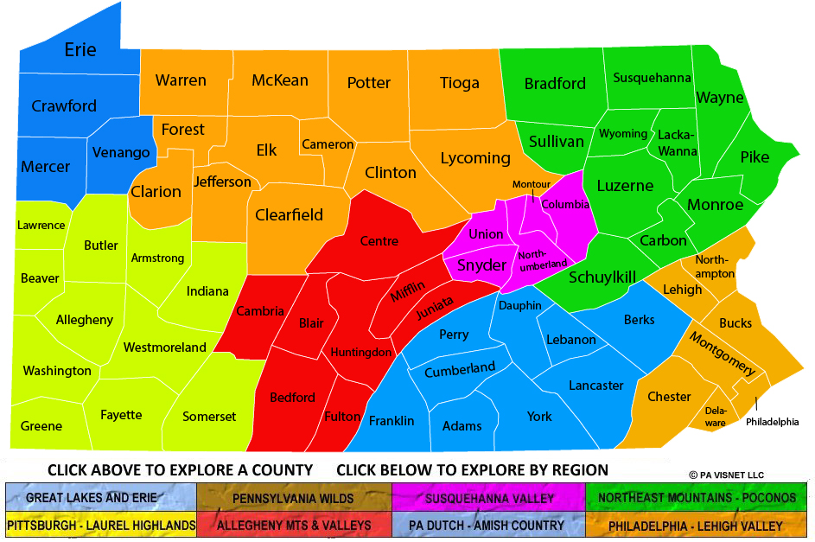
WFS Service Array
50+/- programs; office, community, and 24-hour programs
10,000+ individuals in care/year
1,000 staff and ~200-300 volunteer service providers
Programs and services in Western PA counties
Office locations in 3 counties within a 50-mile radius
  22 IDD Residential Homes
  2 WFS Schools
  2 Admin, 11 Program, thousands of community sites

Slide 4
WFS’ Safety Program Development Experience
FSWP and WSS Merger-2017
The merger presented opportunities to combine risk, safety, and security resources.
FSWP and WSS were in the development stages of Active Shooter Response protocols at merger.
  WSS grant to address technology and safety resources.
  FSWP pursuing trainers and protocols.
Combining processes allowed for mutual support and improvement…we could take the best of both worlds.
  The process can’t be oversimplified: ALICE Model and Trained Facilitators
  Managing risk is enduring and safety is a living process.
  We needed processes that were streamlined and scalable.
  We needed to have the right people in the right seats.
  Safety is an extension of our mission and vital to Quality Whole Person Care.
This lead us to….

Slide 5
The WFS Active Threat Workgroup
Project Lead and workgroup composition
Initial goal of rolling out ALICE model to all WFS Staff.
Initial ALICE instructors were identified as program/site leadership or invested individuals.
The group, through various assessments and a SWOT, was tasked with evaluating what strategies could be implemented in advance of an event to ensure knowledge and skill building.
Following several months of meeting, several things became apparent:
  Safety and risk prevention start before a threat ever presents itself
  Active Threat, not Active Shooter was the better approach to process.
  To accomplish an effective Active Shooter/Threat response, we had to go back to the basics of general safety.
  WFS needed a model that would support staff, students, participants, and volunteers.
The Group’s intent also evolved….

Slide 6
Our Business Case : Run, Hide, Fight
Multiple modalities of Active Shooter training are available, but they essentially all apply the same principles
Support from consultants and local police departments to develop tools and resources
Risk sensitivity and staff feedback about content
Service array applicability
Filling in gaps to ensure a Trauma Informed approach to delivery
  Content monitoring
  Debriefing Tool
Resources and Trainings that could be molded to meet program needs, schedules, etc.
This resulted in WFS selecting the Run, Hide, Fight model, provided by the US Department of Homeland Security.

Slide 7
Additional Responsibilities of the Active Threat Workgroup
Defined the concept of incident command and outlined the roles and responsibilities of these individuals.
Created tools for off-site rally point location determination and agreement, and community/emergency outreach.
Developed trainings and drill concepts for:
  General Staff RHF
  Incident Commanders
  RHF Drills
Assembled Go Bags and Additional Resources.
Updated the ERP, CSH, and other visual tools at WFS.

Slide 8
What are Incident Commanders?
Incident Commanders:
  Site specific individuals who are responsible for assembling staff to complete necessary tools.
  Go-to people on sites for incident response.
  Staff responsible for facilitating drills.
  Individual that will support successful evacuation, debrief, and reassembly following an incident on site.
Every WFS site has at least 1 Incident Commander.

Slide 9
WFS Safety Tools and Resources
Proactive: These are completed as we open a new site and revisited periodically or at specific intervals.
In-House Development of RHF training, using evidence-based resources.
Site Entry/Access Procedures
Site Inspections with safety monitoring and E-tickets
Automated Fire Drill and Active Threat schedules, reporting, and data review
“Safety” on program meeting agendas
Responsive: These are utilized during an emergency.
Emergency Response Plans
Emergency Evacuation Plans
  Updates
Tangible Items: These must be managed and monitored and are utilized during an emergency.
WFS Go Bags-more on next slide
AED machines and OSHA Guided First Aid Kits
Window and Office Numbering
Active Threat and Fire Drills

Slide 10
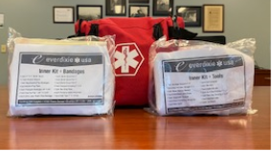
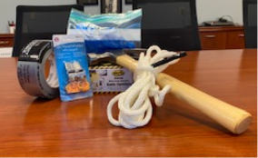
WFS Go Bags and Active Threat Drills
Go Bags include, but are not limited to:
  First aid kit
  Whistle
  Rope
  Radio
  Color coded window cards
  Dry erase marker
  Duct tape
  Hammer
Active Threat Drills:
  Quarterly, attendance is not mandatory but recommended
  Live, Discussion, and Table-top formats
  RHF, Office, Community, and Residential topics pulled from the CSH
  Debriefing tools
  Ticket System and Feedback Loop
  Relias E-Learning Library
  Let’s look at one together.

Slide 11
Community Tools and Resources
Off-Site Rally Point Determination Tool and Agreement (Non-WFS)
Police Department Procedures Alert
WFS Internal Emergency Alert System
WFS Community Safety Handbook
  Comprehensive guide that addresses multiple community threats to safety
  Contains a community safety assessment and multiple procedural areas
  Digital availability: QR Code and ID Badges

Slide 12
How is this all monitored?...
Committees
Exit Tickets
Surveys
Assessments and Inspections

Slide 13
Committee Oversite of Agency Safety
Risk Prevention and Management Committee
Attendees:
Executive Leadership, Directors, certain managers
Guidelines:
WFS Risk Plan
Safety Committee
Attendees:
Open to any staff, with standing membership, for a two-year commitment. All sites represented.
Frequency:
Monthly
Building Governance
Attendees:
All Staff are welcome to participate
Frequency:
Monthly
Frequency:
Odd months
Guidelines:
PA DOL Handbook and Committee Bylaws
Guidelines:
Internal Procedure

Slide 14
Committee Oversite of Agency Safety
RPM
Safety Committee
Objective is to monitor safety concerns, implement proactive solutions, and ensure adherence to safety regulations and guidelines across all sites.
PA Certified Safety Committee
Building Governance
Objective is to create an outlet at all sites to allow any staff to participate in discussions related to building needs, celebrations, and safety.
Consistent agenda template and structure is utilized, and this is conducted by trained facilitators.
All other working WFS committees report to RPM.
Objective is to review incident and risk data and resolve issues and concerns.

Slide 15
In Summary
Remember:
  Venture away from singular training and utilize ongoing learning opportunities to solidify concepts.
  Safety is everyone’s responsibility.
Let’s review some tools we have discussed.
  Community Safety Handbook
  Tabletop Drills
  Live Drill Scenarios

